Slide 1
EMMREM Predicted Dose Rates for CRaTER
N. Schwadron, L. Townsend, K. Kozarev, H. Spence, M. Golightly et al.

Slide 2
Motivator ..

Slide 3
Modulation Potential
Modulation potential, Φ = |Z e|φ(r); barrier to penetrations of CRs
Integral in (1) extends from the inner boundary at radius r to the outer modulation boundary R_{b},
Solar wind speed is V (x) and κ₁(x) is related to the radial diﬀusion coeﬃcient, κ
κ based on ﬁt to observed spectrum over time and species [O’Neil and Badhwar, 2006]: κ = κ₁(r) P β where P is the rigidity in GV, β is the particle speed over the speed of light, κ₁(r) ∝ 1 + (r/r₀)² and r₀ = 4 AU
Reductions in modulation potential are caused by enhanced diffusion, allowing greater access and therefore higher fluxes of GCRs in the inner heliosphere

Slide 4
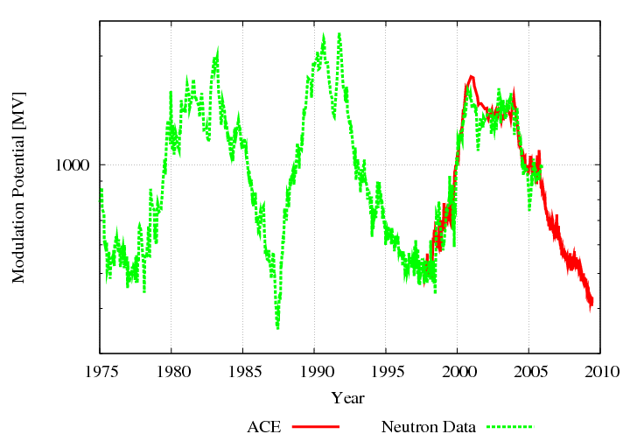

Slide 5
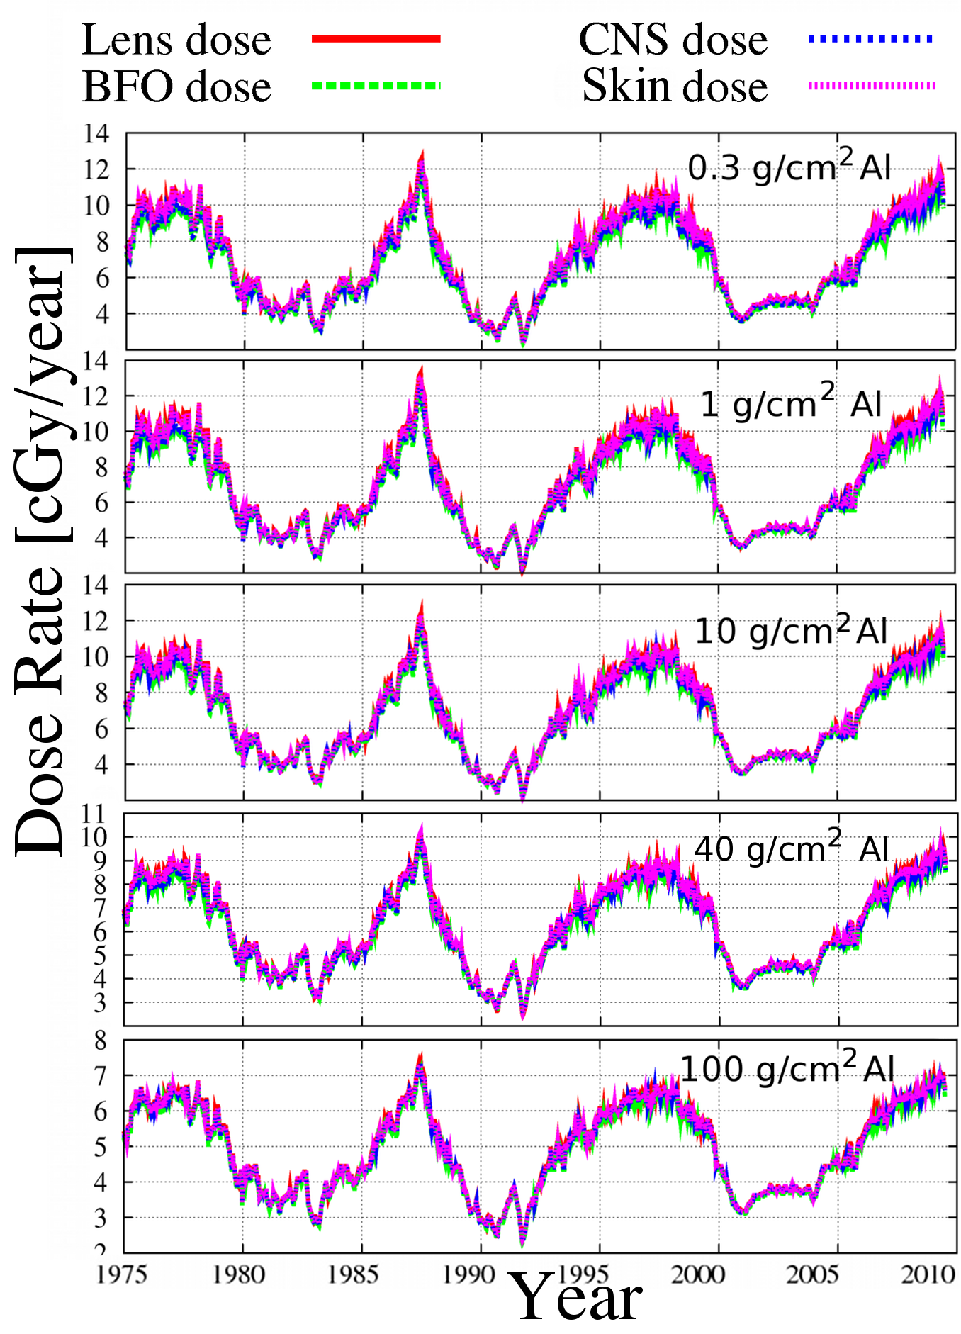
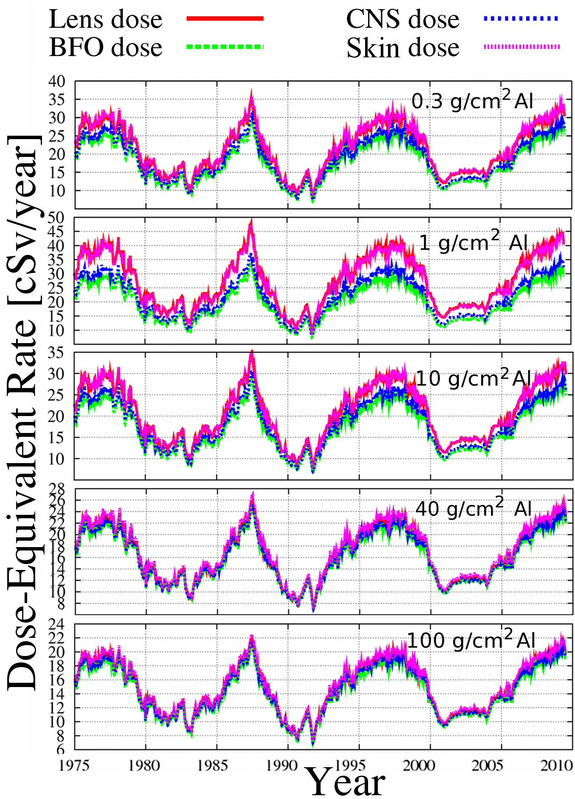

Slide 6
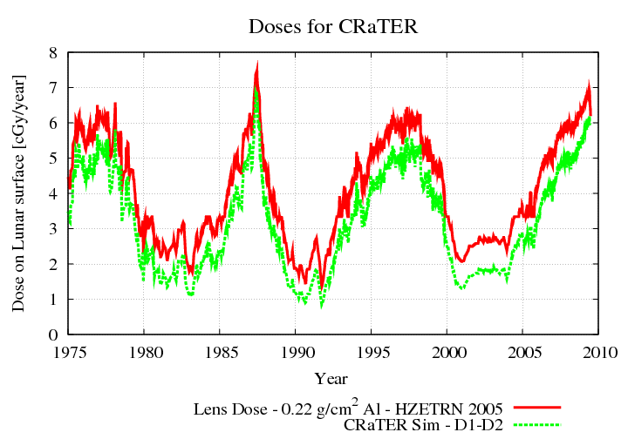
Predictions for LRO CRaTER

Slide 7
Revisions to Original Predictions
The extended solar minimum shows lowest field strengths through space age; but why isn’t the modulation potential at a minimum?
Base modulation potential on ACE and Thule Neutrons ..
Characterize modulation potential in terms of field strength (extensions back to Maunder Minimum and before)
Is there an effect of the shrinking heliopshere in the extended solar minimum?

Slide 8
Revised Modulation Potential

Slide 9
Revised Doses using Thule Neutron Monitor Data

Slide 10
Modulation Potential
Modulation potential, Φ, should scale with some power of the field strength or radial field strength
Motivated by recent work on the Closed flux ejected by CMEs over the solar cycle

Slide 11
CMEs Add
Closed Flux
To Heliosphere

Slide 12
Model for CME Injection of Closed Magnetic Flux

Slide 13
Correlation Between Field Strenght and Modulation Potential

Slide 14
McCracken and Beer, JGR, 2007
-- Annual ¹⁰Be data (1428–1930) averaged with binomial filter; the other data are annual averages.
-- Line Cnm(LIS) estimated pseudo-Climax counting rate in the absence of any solar modulation
-- Heavy lines indicate the levels of “residual modulation” during the four Gleissberg maxima.
-- Arrows between 1533 and 1686 are at 22-year intervals
-- Removed Effects of long-term change in geo dipole, and prod. of ¹⁰Be by solar cosmic rays

Slide 15
Derived from Cosmic Ray Record
McCracken, JGR, 2007
-- Estimated annual average heliospheric magnetic field strength near Earth, 1428–2005
-- heavy lines are estimates of the heliomagnetic floor values for the several Gleissberg cycles

Slide 16
Modulation Potential Paleo Record
Field strengths reduced by 5-10 from historical record
Implications modulation potentials of 6-20 (as opposed to 400 currently)
Need to run much smaller modulation potentials to know how bad the environment can get

Slide 17
Is there an Effect of the Shrinking Heliosphere?
Reduction in modulation potential more than adequately accounted for by changes in field strength
The effect of a reduction in size of heliosphere remains elusive

Slide 18
Takeaway
We have a story to tell with dose rate comparison
But we are missing the comparison part

